Slide 1
Math 152
Lesson | Topic | Reading
30 | Power Series/Representation of Functions as Power Series | 11.8/11.9
31 | Taylor and Maclaurin Series | 11.10
32 | Applications of Taylor Polynomials | 11.11
Objectives:
Calculate the coefficients for a power series expansion
Understand that a Maclaurin series is a Taylor series centered at zer o
Develop a Taylor series expansion for a given function
Describe the relationship between a Taylor Series expansion, and an nth-degree Taylor poynomial of a function

Slide 2
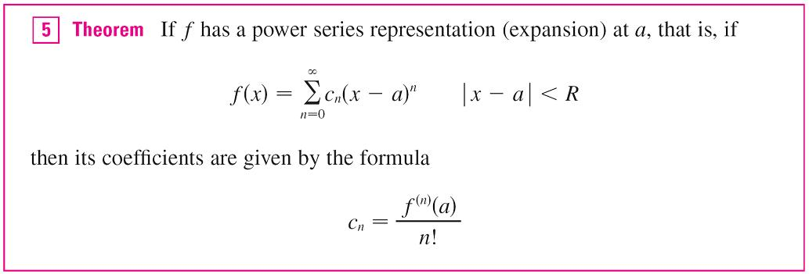
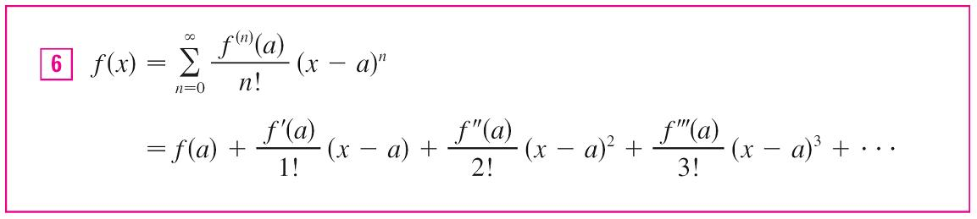
Taylor Series
Power Series: f (x) = c₀ + c₁(x – a) + c₂(x – a)² + c₃(x – a)³ + c₄(x – a)⁴ + . . . | x – a | < R

Slide 3

Maclaurin Series
For the special case a = 0 the Taylor series becomes
This case arises frequently enough that it is given the special name Maclaurin series.

Slide 4

Example
Find the Maclaurin series of the function f (x) = e^{x} and its radius of convergence.
Solution:
f ^{(n)}(x) = e^{x}, so f ^{(n)}(0) = e⁰ = 1 for all n
R=

Slide 5
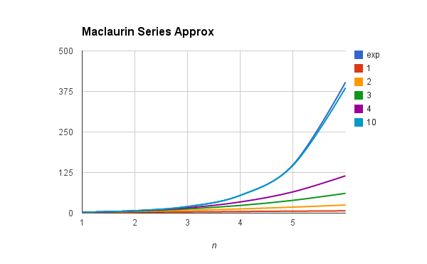
Order of Approx
Higher order approximations are better

Slide 6
Taylor Series Process
Take n derivatives of f(x) and determine a pattern for c_{n}
Substitute c_{n} into Taylor (or Maclaurin) Series
Simplify
Find radius of convergence
Find interval of convergence
Test end points of interval
Remember, f(x) not valid outside of interval

Slide 7
Example
Find the Maclaurin Series for and radius of convergence:
Solution:
|x| < 1, R=1

Slide 8
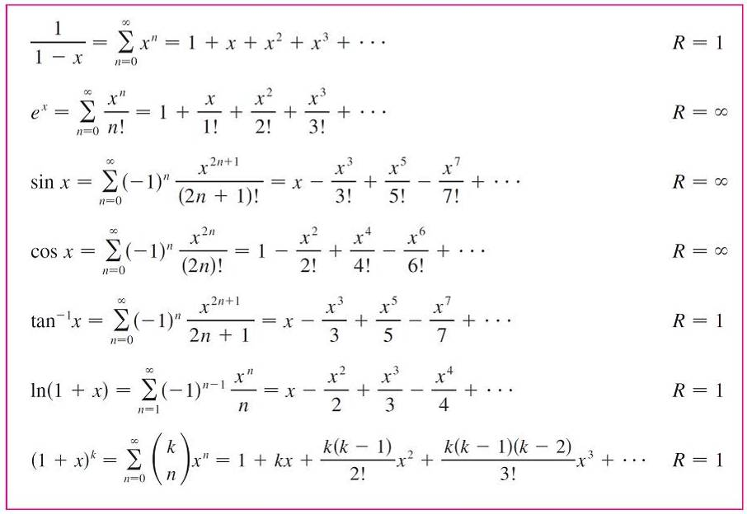
Common Taylor Series

Slide 9
Desk Work
Find the Taylor Series for and radius of convergence:

Slide 10
#3

Slide 11
#6

Slide 12
Backups

Slide 13

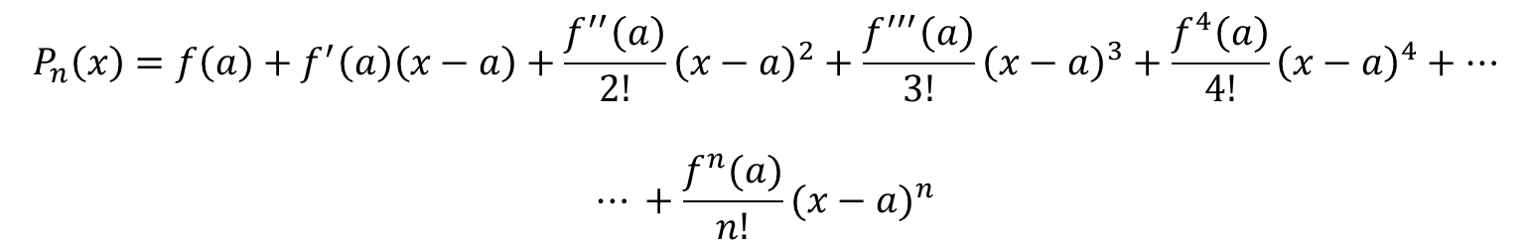

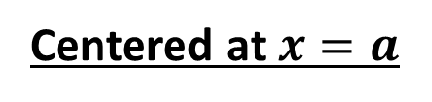
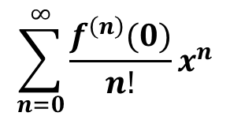
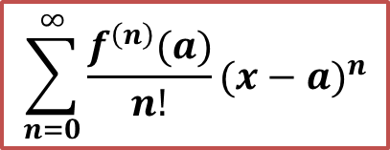
Taylor Polynomial of Degree $n$ Approximating $f(x)$ for $x$ near 0
Centered at $x=0$
$$P_{n}\left(x\right)=f\left(0\right)+f^{′}\left(0\right)x+\frac{f′′(0)}{2!}x^{2}+\frac{f′′′(0)}{3!}x^{3}+\frac{f^{4}(0)}{4!}x^{4}+⋯+\frac{f^{n}(0)}{n!}x^{n}$$
Centered at $x=a$
$$P_{n}\left(x\right)=f\left(a\right)+f^{′}\left(a\right)\left(x−a\right)+\frac{f^{′′}\left(a\right)}{2!}{\left(x−a\right)}^{2}+\frac{f^{′′′}\left(a\right)}{3!}{\left(x−a\right)}^{3}+\frac{f^{4}\left(a\right)}{4!}{\left(x−a\right)}^{4}+⋯$$
$$⋯ +\frac{f^{n}(a)}{n!}{(x−a)}^{n}$$
$$\sum_{n=0}^{∞}{\frac{f^{\left(n\right)}(a)}{n!}{(x−a)}^{n}}$$
$$\sum_{n=0}^{∞}{\frac{f^{\left(n\right)}(0)}{n!}x^{n}}$$

Slide 14
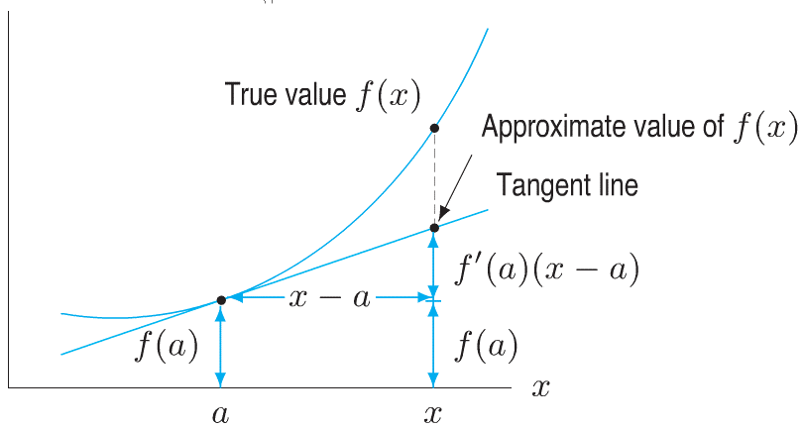
Tangent Line Approximation
Notes:
Only two things required:
The points of the curve and the point of the tangent line were equal at x = a
The curve and the TL had the same slope at x=a

Slide 15
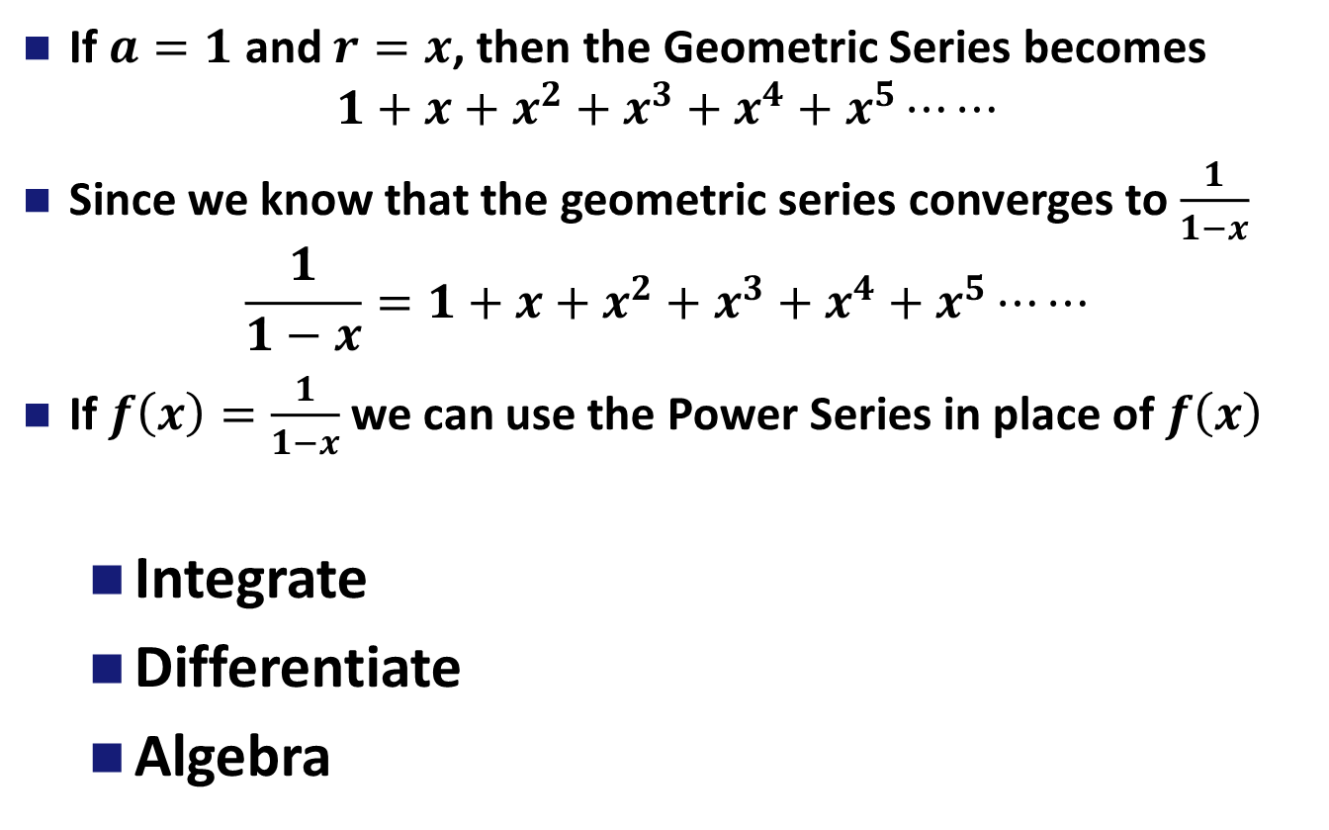
Representing a Function as a Power Series
If $a=1$ and $r=x$, then the Geometric Series becomes
$$1+x+x^{2}+x^{3}+x^{4}+x^{5}⋯⋯$$
Since we know that the geometric series converges to $\frac{1}{1−x}$
$$\frac{1}{1−x}=1+x+x^{2}+x^{3}+x^{4}+x^{5}⋯⋯$$
If $f\left(x\right)=\frac{1}{1−x}$ we can use the Power Series in place of $f\left(x\right)$
Integrate
Differentiate
Algebra
Notes:
Geometric series, where a = 1, and r = x
Ask for radius of convergence

